Slide 1
Optimising Developing Heart Growth Problem
Hashem Yousefi

Slide 2
Outline
Update on work done in the previous week
Issues which are not resolved
Action items from the other aspects
Plans for the following week
Submitting to the EMAC proceeding

Slide 3
Last Week
Importing the meshes and getting the derivatives
Applying time variation ability to the code
Getting an estimation of the objective function
Looking to the online resources for the growth rates
Following up on a report for the Mesh Painting section
Following up on a report for the pros and cons of optimization methods

Slide 4
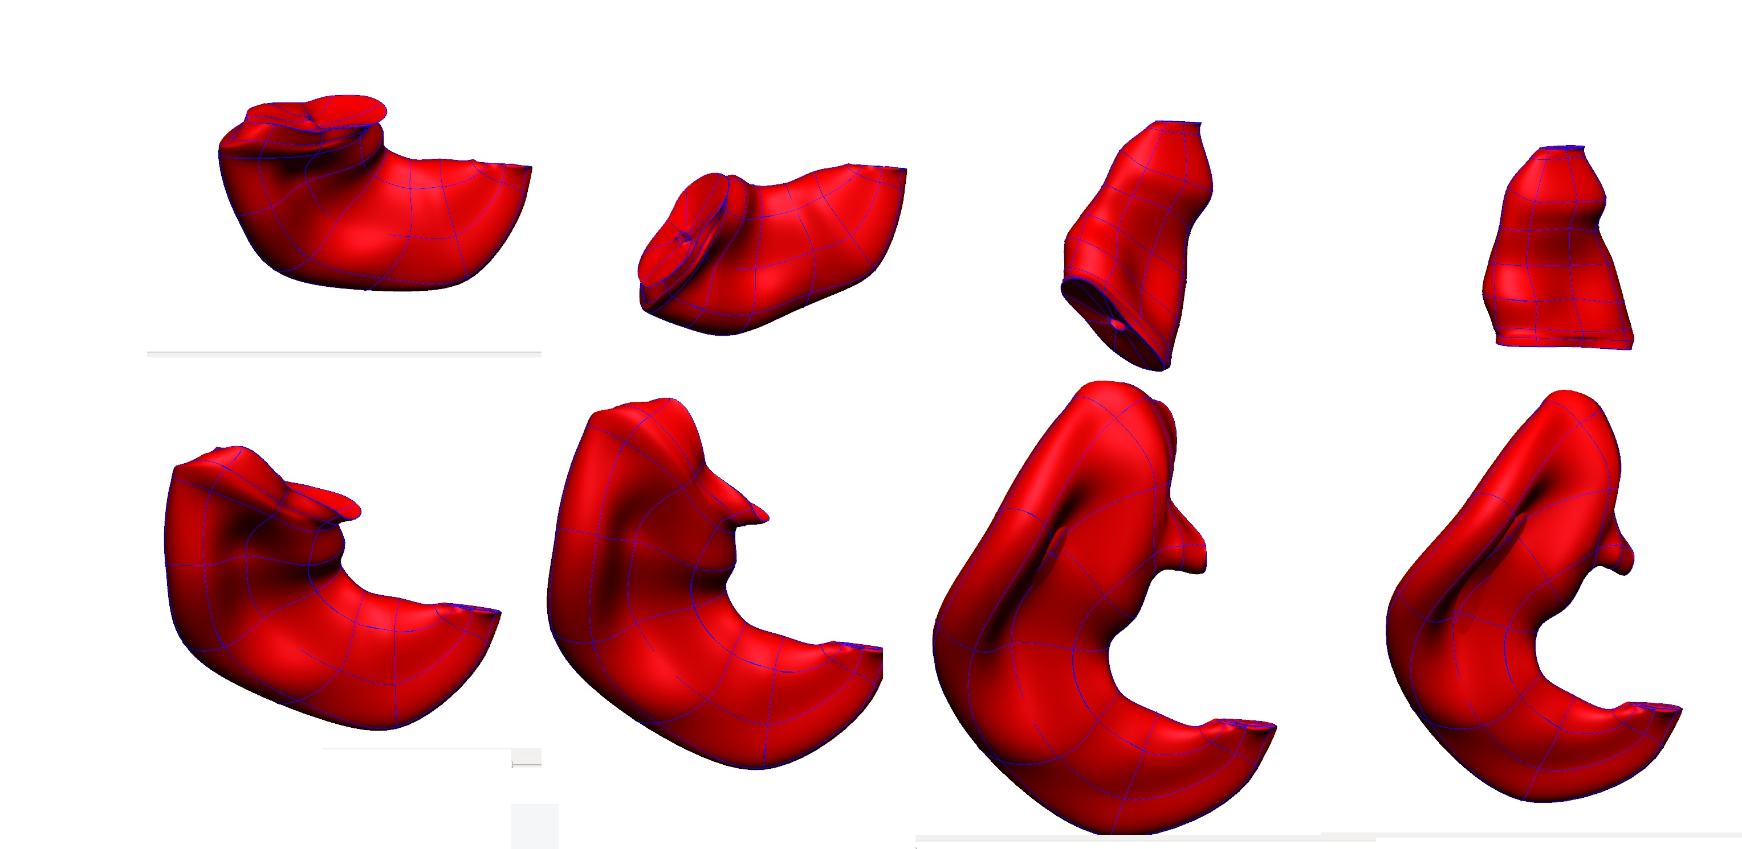
Result of SBending forward code on stage 10

Slide 5
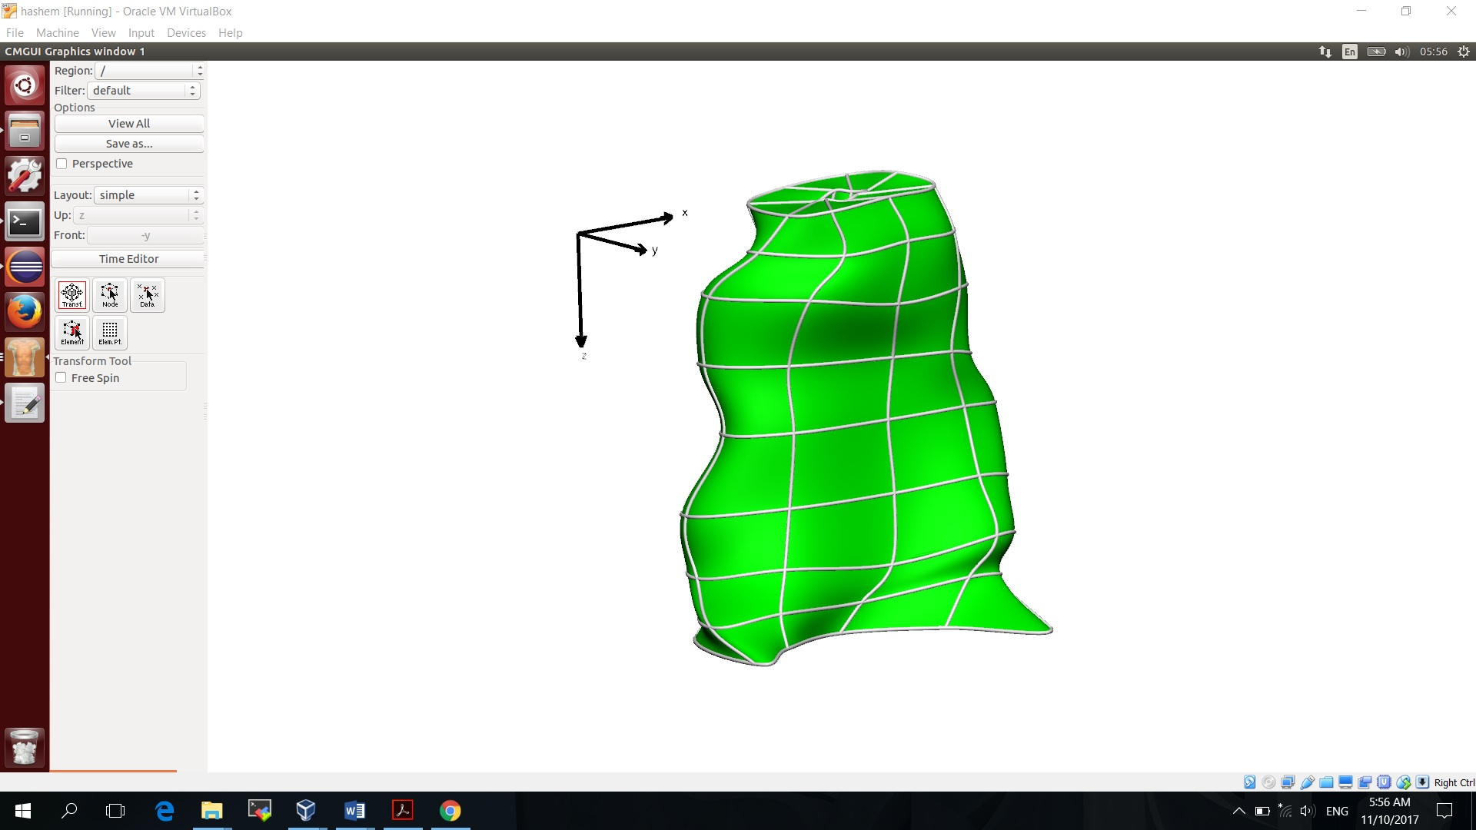
How stage 11 looks different from stage 10

Slide 6
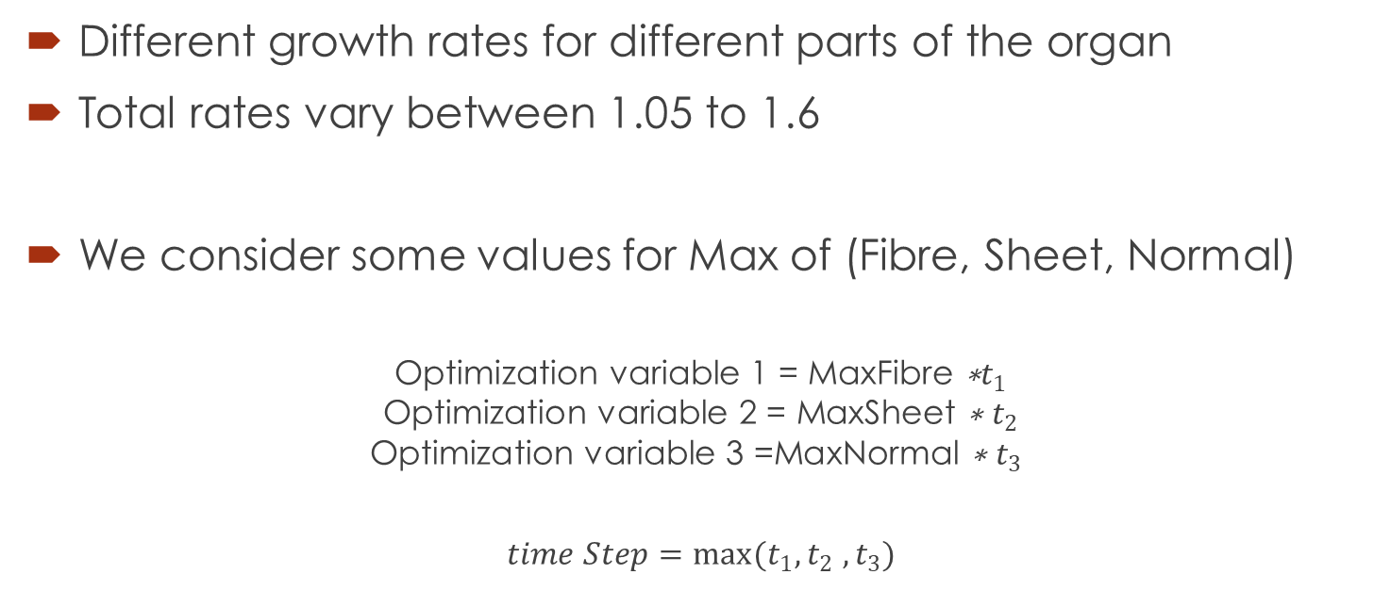
Growth Rate in the Literature
Different growth rates for different parts of the organ
Total rates vary between 1.05 to 1.6
We consider some values for Max of (Fibre, Sheet, Normal)
$$\text{Optimization} \text{variable}\text{ 1 = }\text{MaxFibre} \text{∗}t_{1}$$
$$\text{Optimization} \text{variable}\text{ 2 = }\text{MaxSheet} \text{∗} t_{2}$$
$$\text{Optimization} \text{variable}\text{ 3 =}\text{MaxNormal} \text{∗} t_{3}$$
$$time Step=\max{(t_{1}, t_{2} , t_{3})}$$

Slide 7
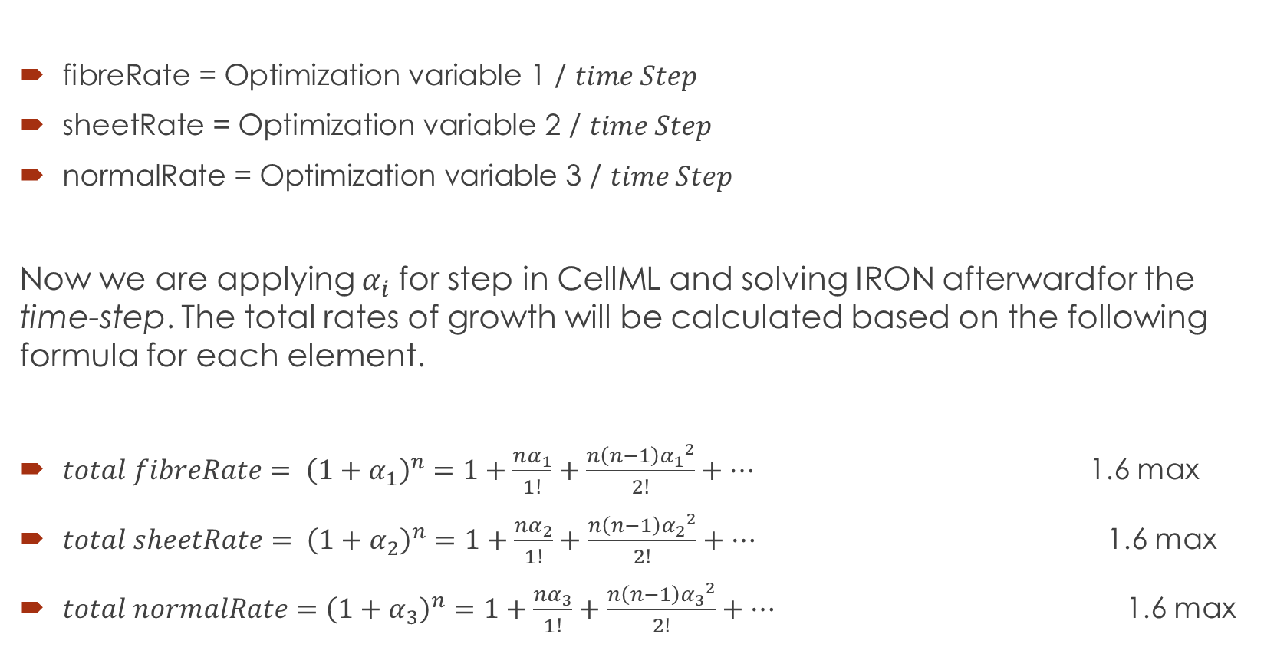
Following on time
$\text{fibreRate}\text{ = }\text{Optimization} \text{variable}\text{ 1 / }time Step$
$\text{sheetRate}\text{ = }\text{Optimization} \text{variable}\text{ 2 / }time Step$
$\text{normalRate}\text{ = }\text{Optimization} \text{variable}\text{ 3 / }time Step$
Now we are applying $α_{i}$for step in CellML and solving IRON afterwardfor the time-step. The total rates of growth will be calculated based on the following formula for each element.
$total fibreRate= {\left(1+α_{1}\right)}^{n}=1+\frac{nα_{1}}{1!}+\frac{n\left(n−1\right){α_{1}}^{2}}{2!}+…$ 1.6 max
${total sheetRate= \left(1+α_{2}\right)}^{n}=1+\frac{nα_{2}}{1!}+\frac{n\left(n−1\right){α_{2}}^{2}}{2!}+…$ 1.6 max
$total normalRate={\left(1+α_{3}\right)}^{n}=1+\frac{nα_{3}}{1!}+\frac{n\left(n−1\right){α_{3}}^{2}}{2!}+…$ 1.6 max

Slide 8
Problem for the Whole Model to Test 12 Growth Rates with ALHSO / ALPSO / SLSQP
Name | SLSQP | ALPSO | ALHSO
Problem | Stage 10 to 11 in 8*8 model With result of ALPSO | Stage 10 to 11 in 8*8 model Swarm size 5 Swarm size 5 | Stage 10 to 11 in 8*8 model Harmony size 30
Time | 6 hours | 53hours, 20hours | 23 hours,
Minimum Objective Value | No answer, first guess was not close maybe | 5.48e+6 (28 calls) 5.3e+6 (51 calls) | 5.48e+6 (26 calls) 5.42e+6 (49 calls)

Slide 9
Unresolved issues
The codes stops after a number on iterations.
How we need to decide about the origin? (relative registration and absolute registration)
How many points needs to be detected for the origin? (2points or three points or even one???)
Is that possible to solve the model in smaller pieces and then combine them? (It should provide a faster guess)

Slide 10
Next Week Plans
+ Create a to do list in minutes ….
+ Checking if the model can be solved in smaller pieces
+ Checking for other stages, maybe they are more flexible
+ Optimisation Report is complete now ?
+ Add notation (for terms) + …. Still ambiguous (maybe Jagir can help more closely in writing some parts)
+ Work with the B.Cs.
+ How to run in parallel … how to use NeSI
+ Create a courser model as an alternative to solving smaller pieces ()
+

